Slide 1
New Road Surgery
Patient Participation Group (PPG)
Steering Group Meeting
23rd May 2023

Slide 2
Team Changes
Sad goodbye and massive thank you to Paula Dean, who is leaving us after 15 years of exceptional patient centred care
Introduction to Sharon Taylor, our new Reception Team Lead
Also to Elizabeth Smith who will be stepping down from her dispensing role in Sarratt after over 40 years dedicated service to the community

Slide 3
Sarratt Action Plan
Pause dispensing – provision for patients to request prescriptions online or via their usual pharmacy. We will then send electronically to their usual pharmacy via EPS, patient can pickup medications or get home delivery
Recruit new receptionist/dispenser
Advise Sarrat community – village shop, Parish Council, residents association

Slide 4
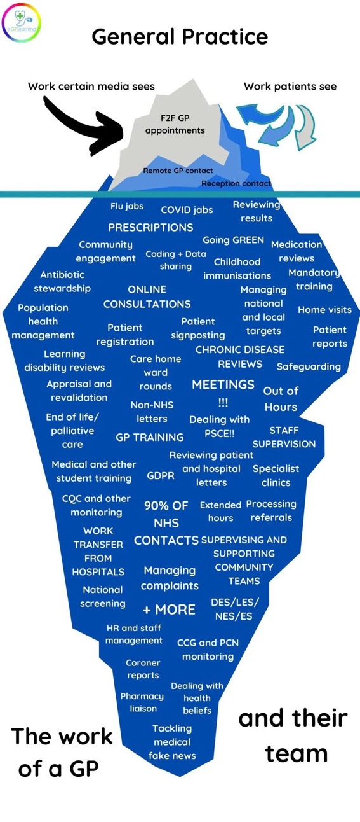
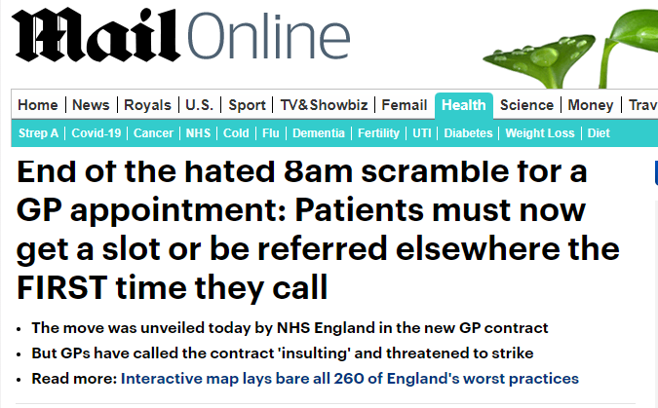
Demand, Capacity and Access

Slide 5
Demand, Capacity and Access
Can’t reduce demand – increasing
Can’t increase capacity – NHS funding, premises, staffing
Review Access

Slide 6
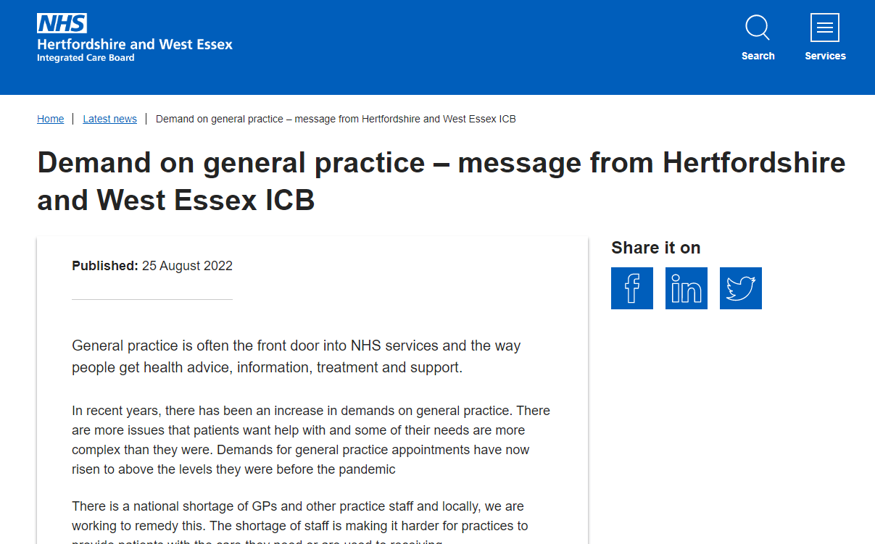
https://hertsandwestessex.icb.nhs.uk/

Slide 7
Access
Some practices have moved to total triage model where the patient or receptionist completes a form detailing the patient need and this is then clinically assessed and appointments arranged as necessary with appropriate clinician via appropriate method – telephone, F2F, text response etc

Slide 8
Roles, PPG management and administration
Appointment of Chair/vice-chair and secretary
Chairperson: nominated by, seconded by
Vice chair: nominated by, seconded by
Secretary: nominated by, seconded by

Slide 9
PPG Goals and Objectives 2022
Recruit PPG Steering Group roles and diverse participants including carers, young people, hard to reach groups.
Support the practice at events – for example attend vaccination clinics and promote NHS app
Promote ownership/involvement with the surgery
Communication about what the surgery does and how best to access services – including appointments, changes to delivery of evening/weekend appointments, phone queuing to book appointments
Consider impact of changes on individuals including those with protected characteristics

Slide 10
PPG Goals and Objectives 2023
Recruit PPG Steering Group roles to support ongoing PPG meetings
Appoint Chair and Secretary
Support the practice in demand, capacity and access planning
Extend wider PPG

